Slide 1
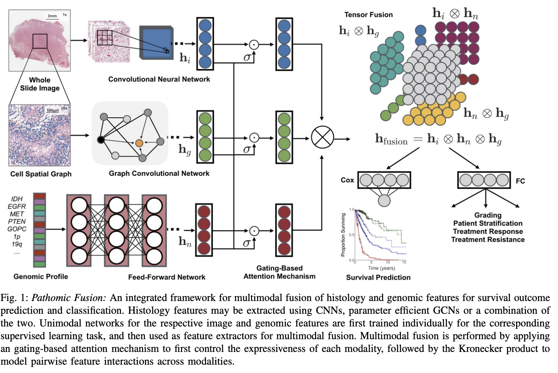
1. Pathomic Fusion (in IEEE-TMI)

Slide 2
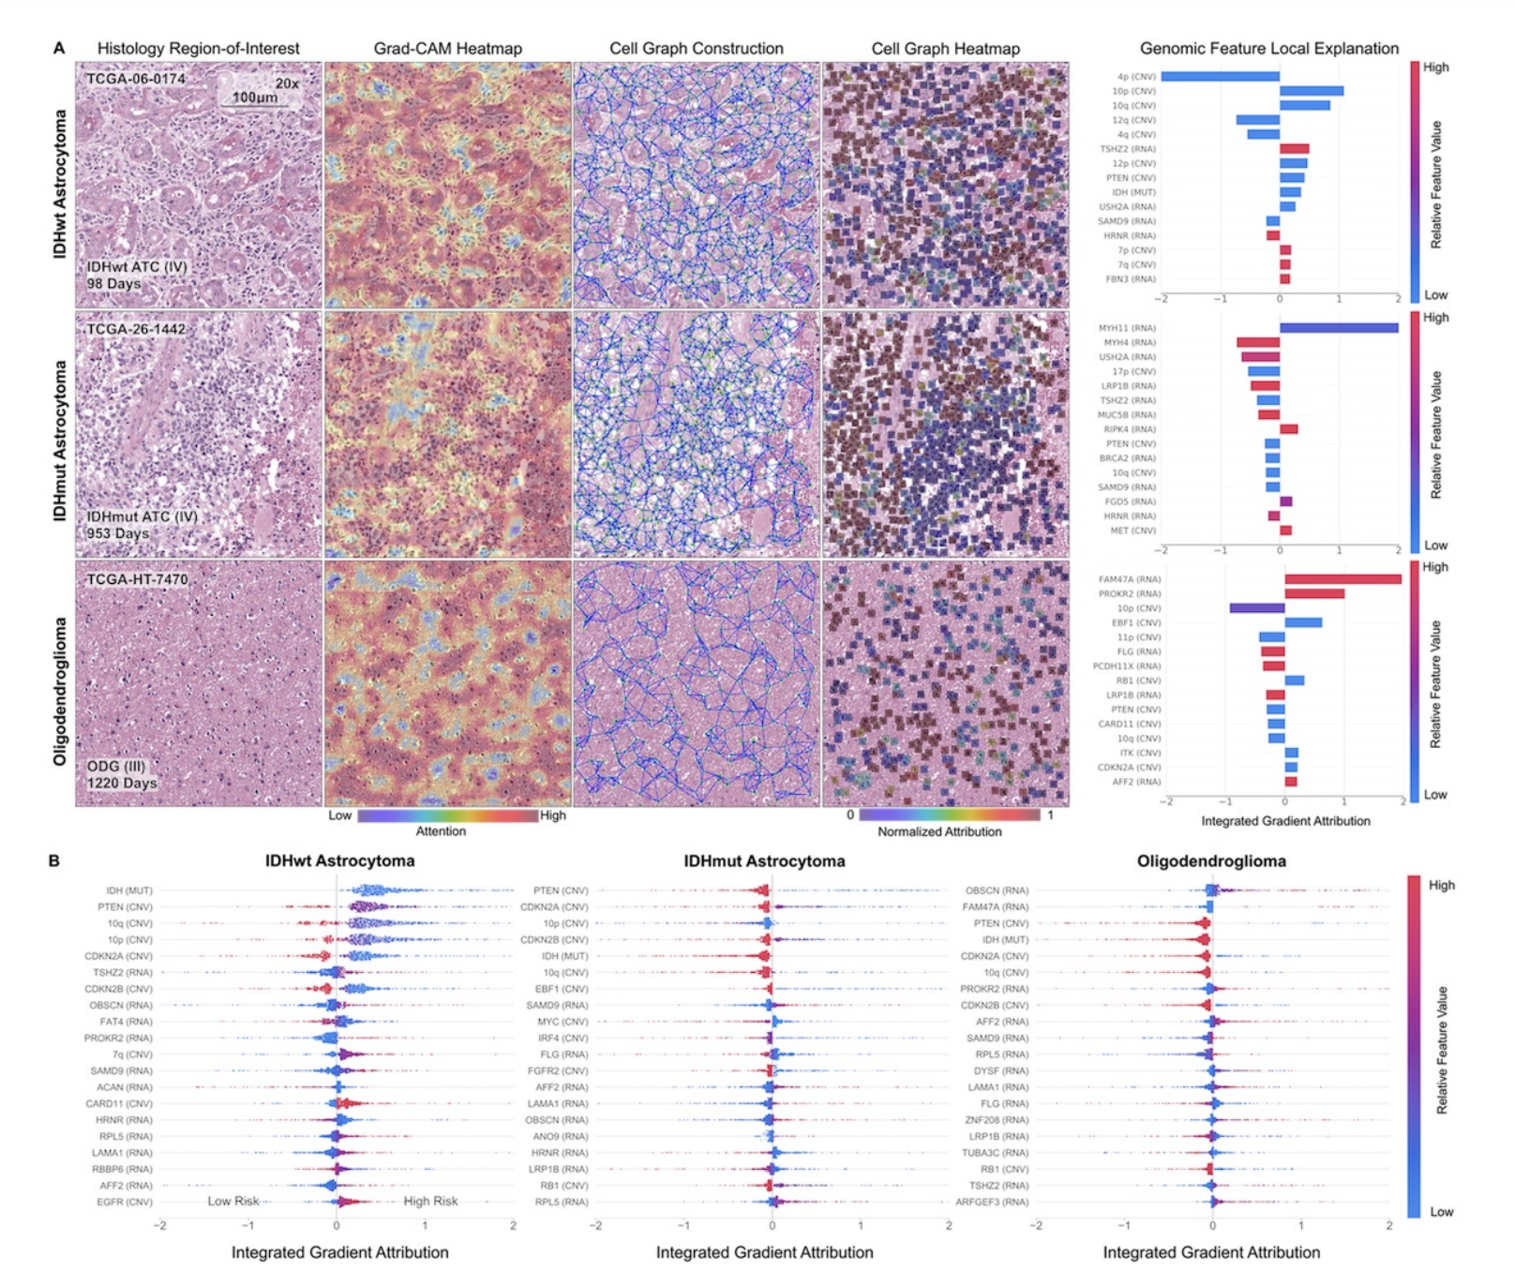
1. Pathomic Fusion (in IEEE-TMI)
Interpretability of image + graph + genomic modalities
Image interpretability performed using GradCAM
Graph + genomic interpretability performed using Integrated Gradients
Histology Interpretability
IDHwt ATC: Endothelial cells of the microvascular proliferation
ODG: Fried-egg cells
Genomic Interpretability
Canonical biomarkers such as IDH< PTEN, MYC, CDKN2A

Slide 3
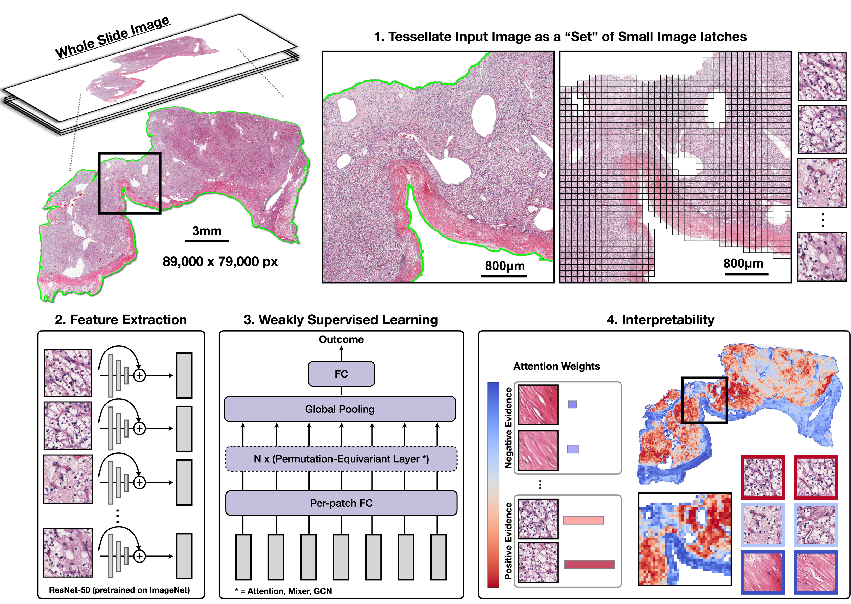
Formulate gigapixel image as a "bag / sequence" of non-overlapping 256 x 256 patches
Average sequence length is 15,234 patches
Use ResNet-50 encoder pretrained on ImageNet to extract 1024-dim embeddings per patch
Weak supervision via Attention MIL [Ilse et al. ICML18] to aggregate embeddings
2. CLAM (Nature BME)

Slide 4
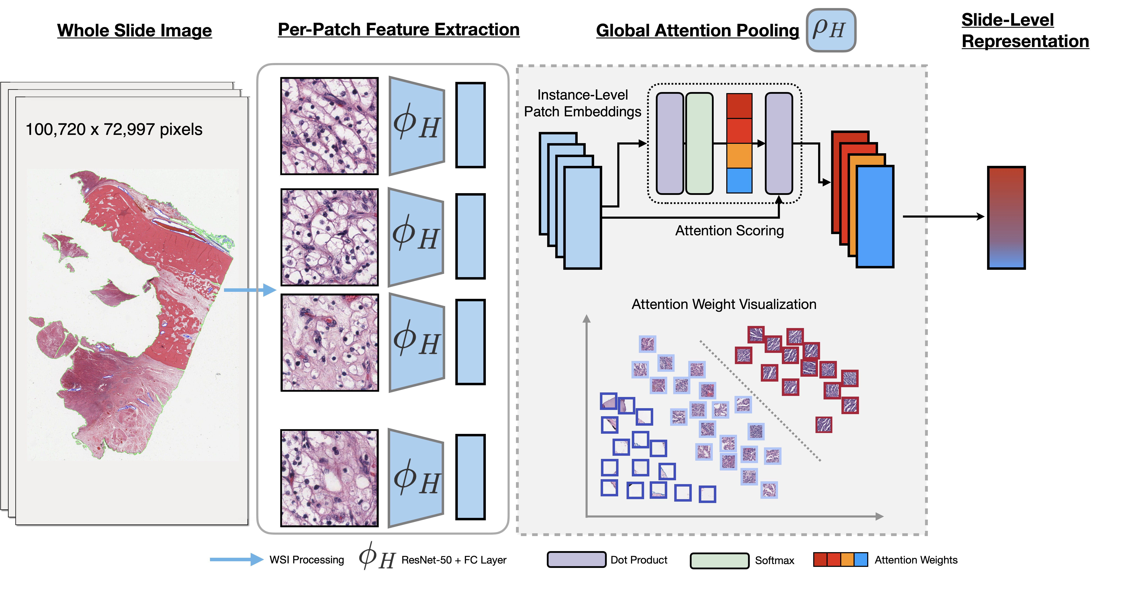
Formulate gigapixel image as a "bag / sequence" of non-overlapping 256 x 256 patches
Average sequence length is 15,234 patches
Use ResNet-50 encoder pretrained on ImageNet to extract 1024-dim embeddings per patch
Weak supervision via Attention MIL [Ilse et al. ICML18] to aggregate embeddings
2. CLAM (Nature BME)

Slide 5
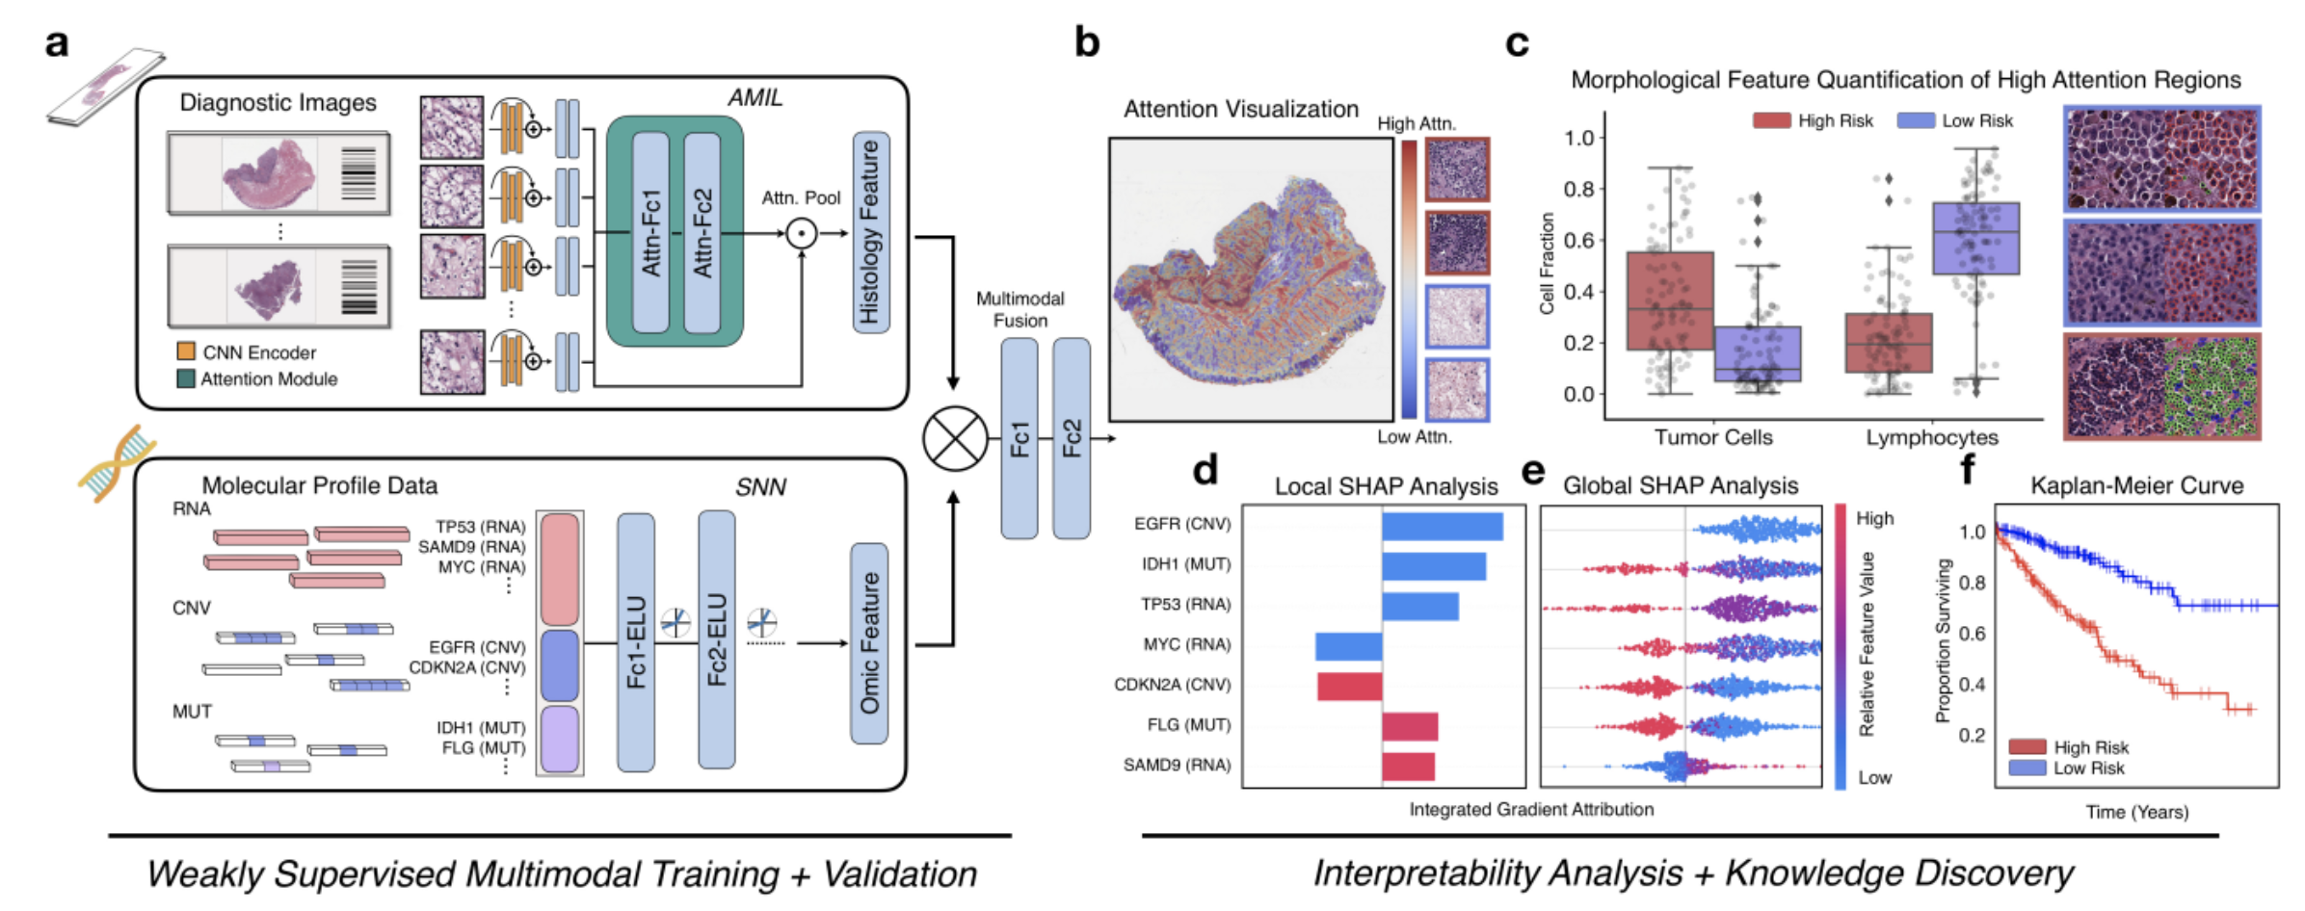
3. PORPOISE (Submitted to Cancer Cell)
http://pancancer.mahmoodlab.org

Slide 6
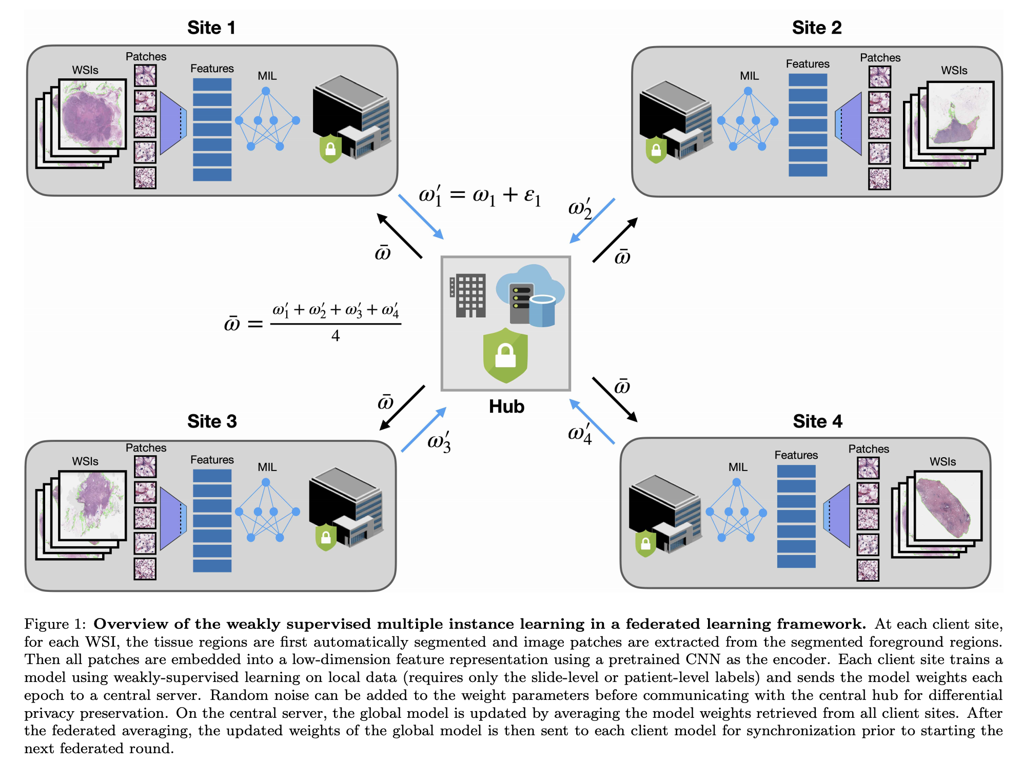
4. HistoFL (Submitted to Medical Image Analysis)

Slide 7
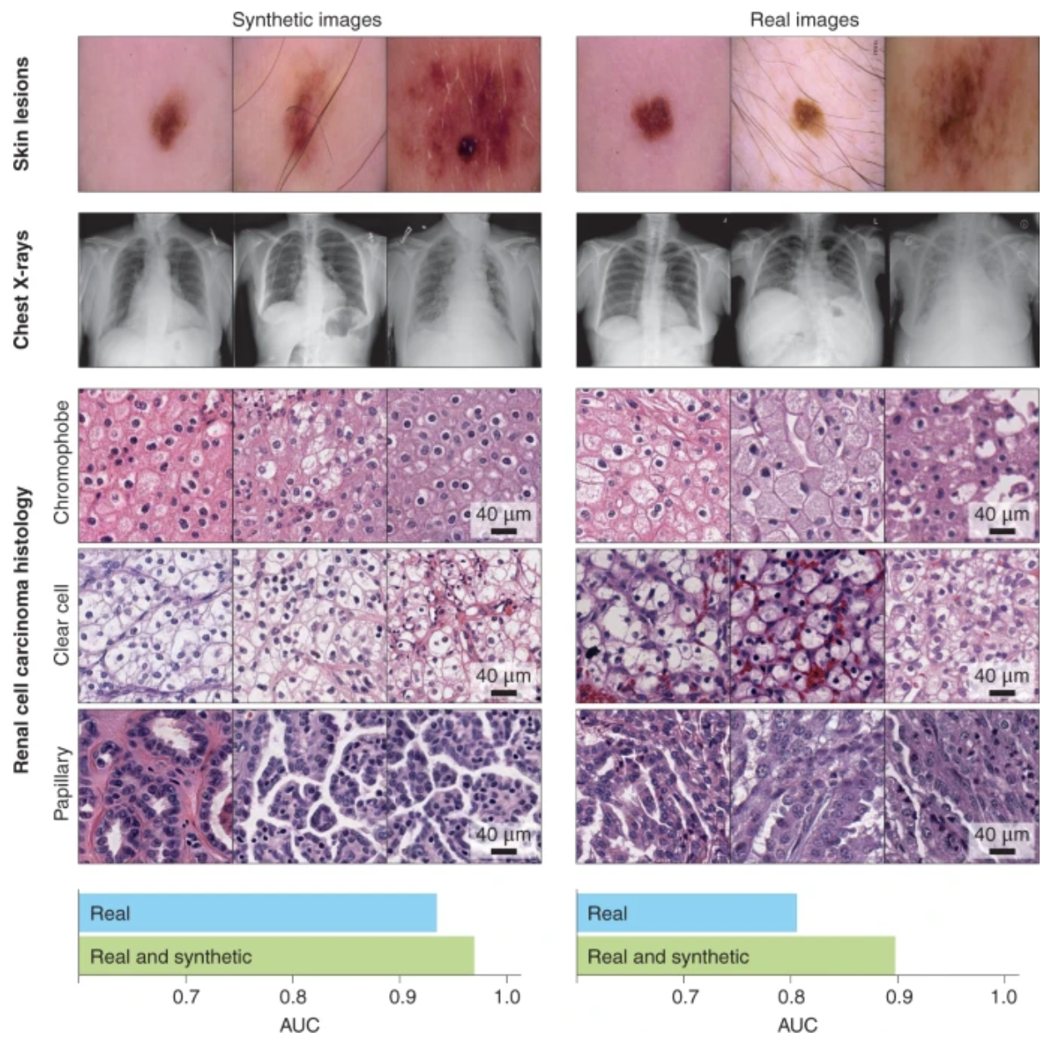
5. Synthetic data in machine learning for medicine and healthcare (Nature BME)

Slide 8
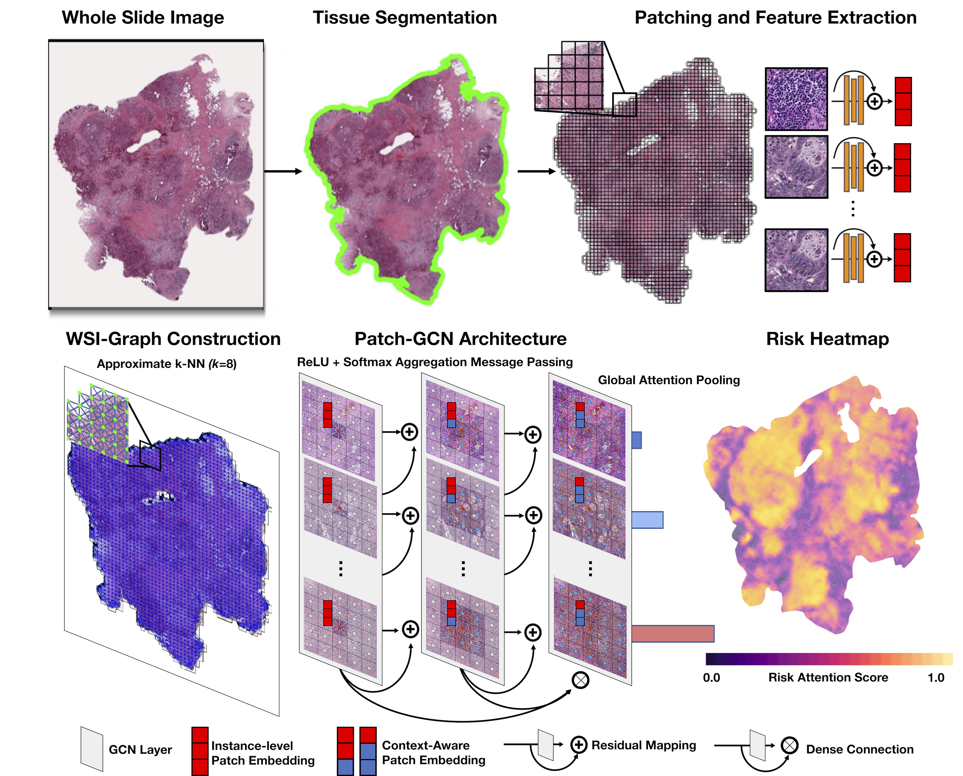
6. Patch-GCN (MICCAI 2021)
Treat extracted ResNet-50 feature embeddings as nodes in a 2D point cloud
Nodes connected via K-NN spatially adjacent to other nodes by (x,y)-coord
Use GCN as backbone for feature aggregation, followed by global pooling for weak supervision

Slide 9
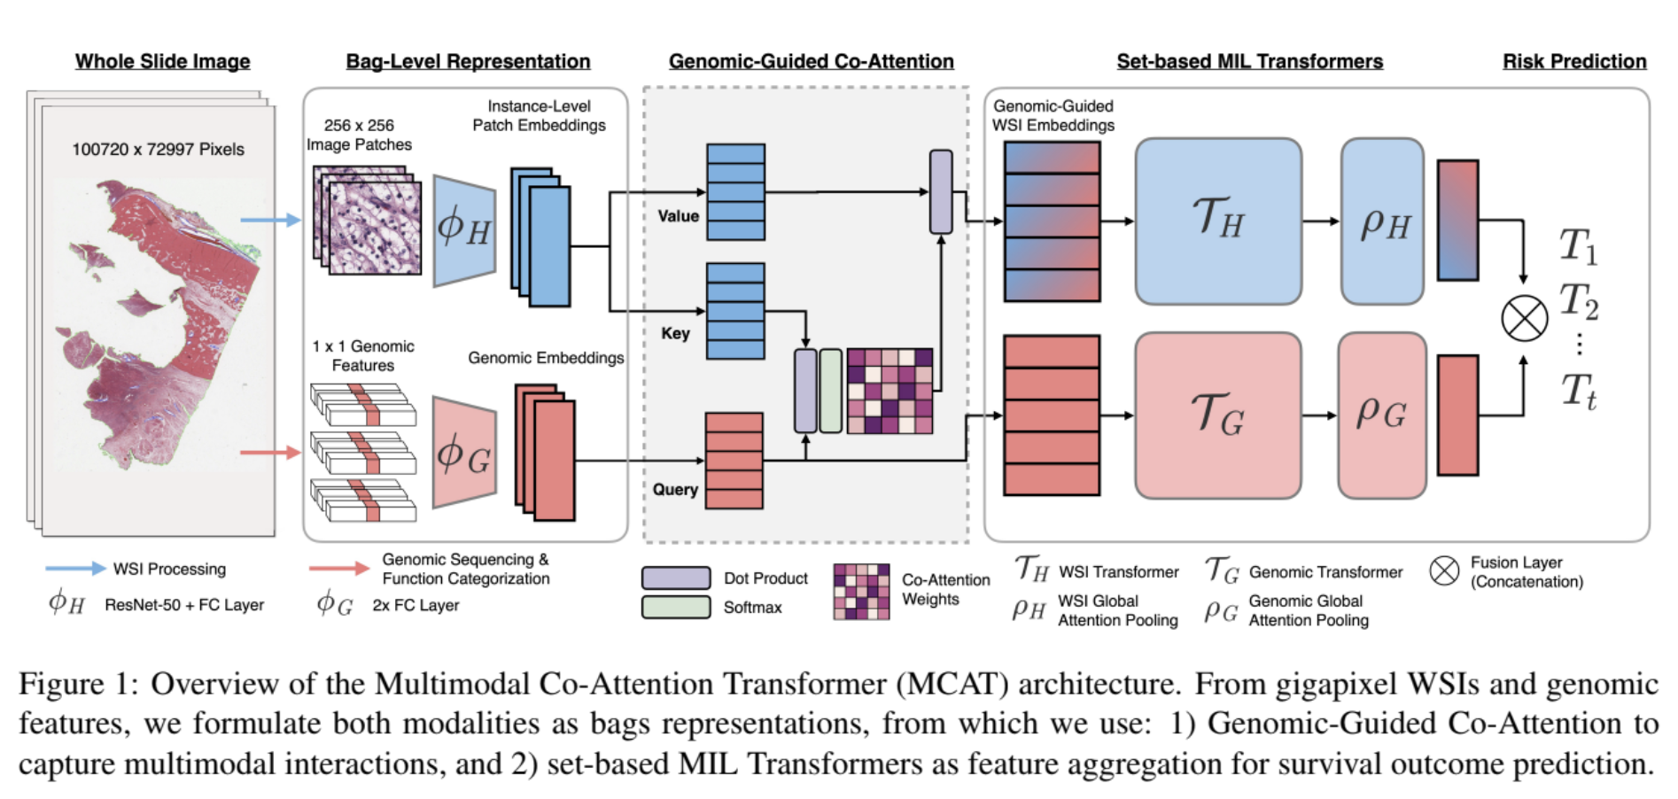
7. MCAT (ICCV 2021)

Slide 10
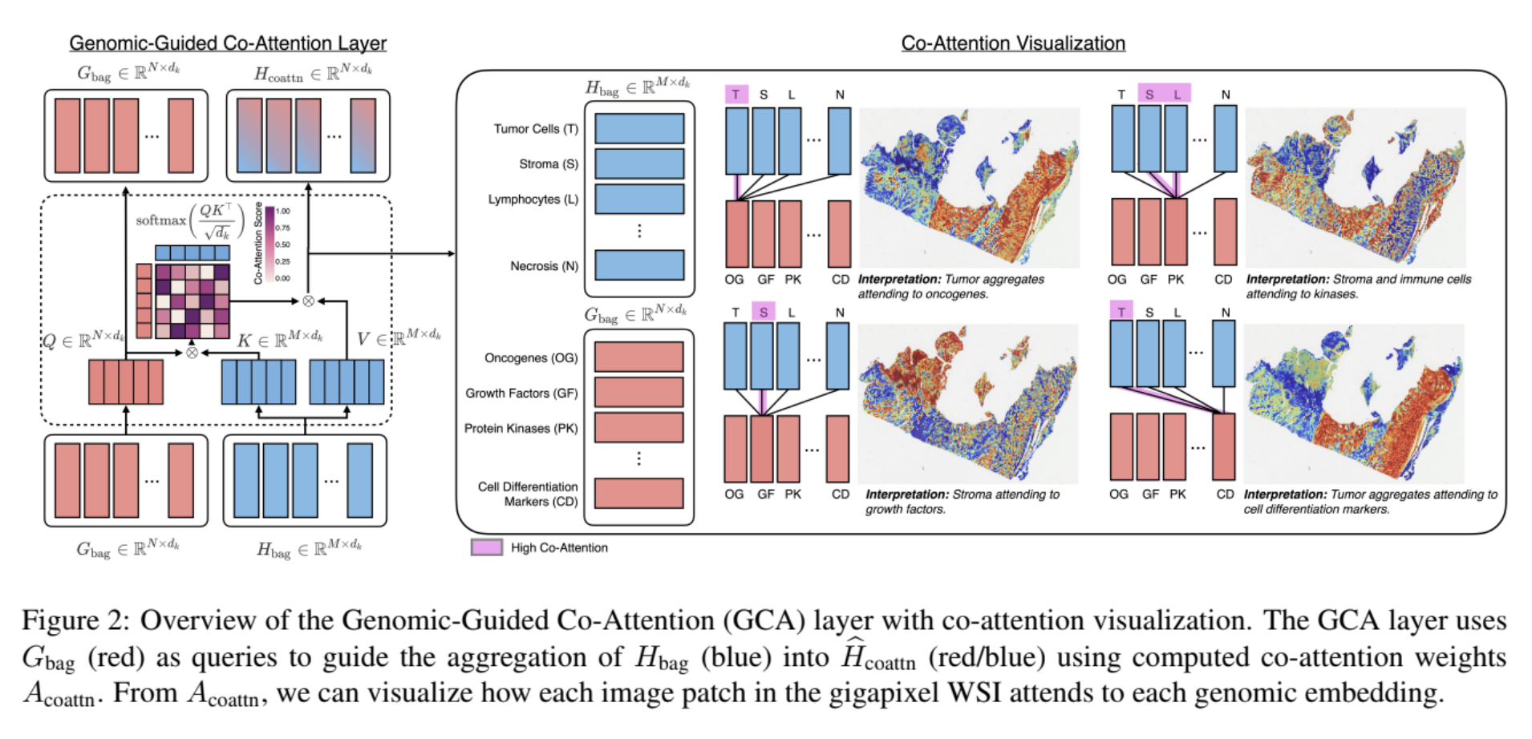
7. MCAT (ICCV 2021)

Slide 11
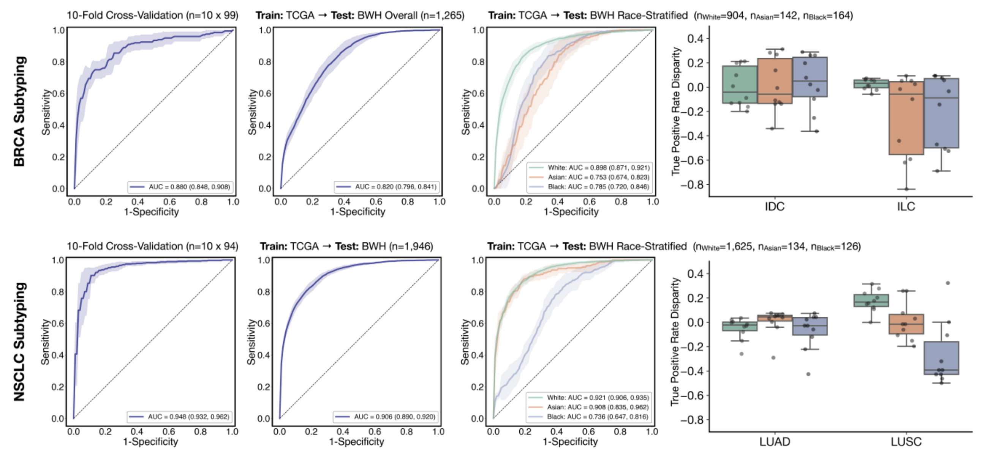
8. Race Disparities in AI Models (Submitted to JAMA)

Slide 12
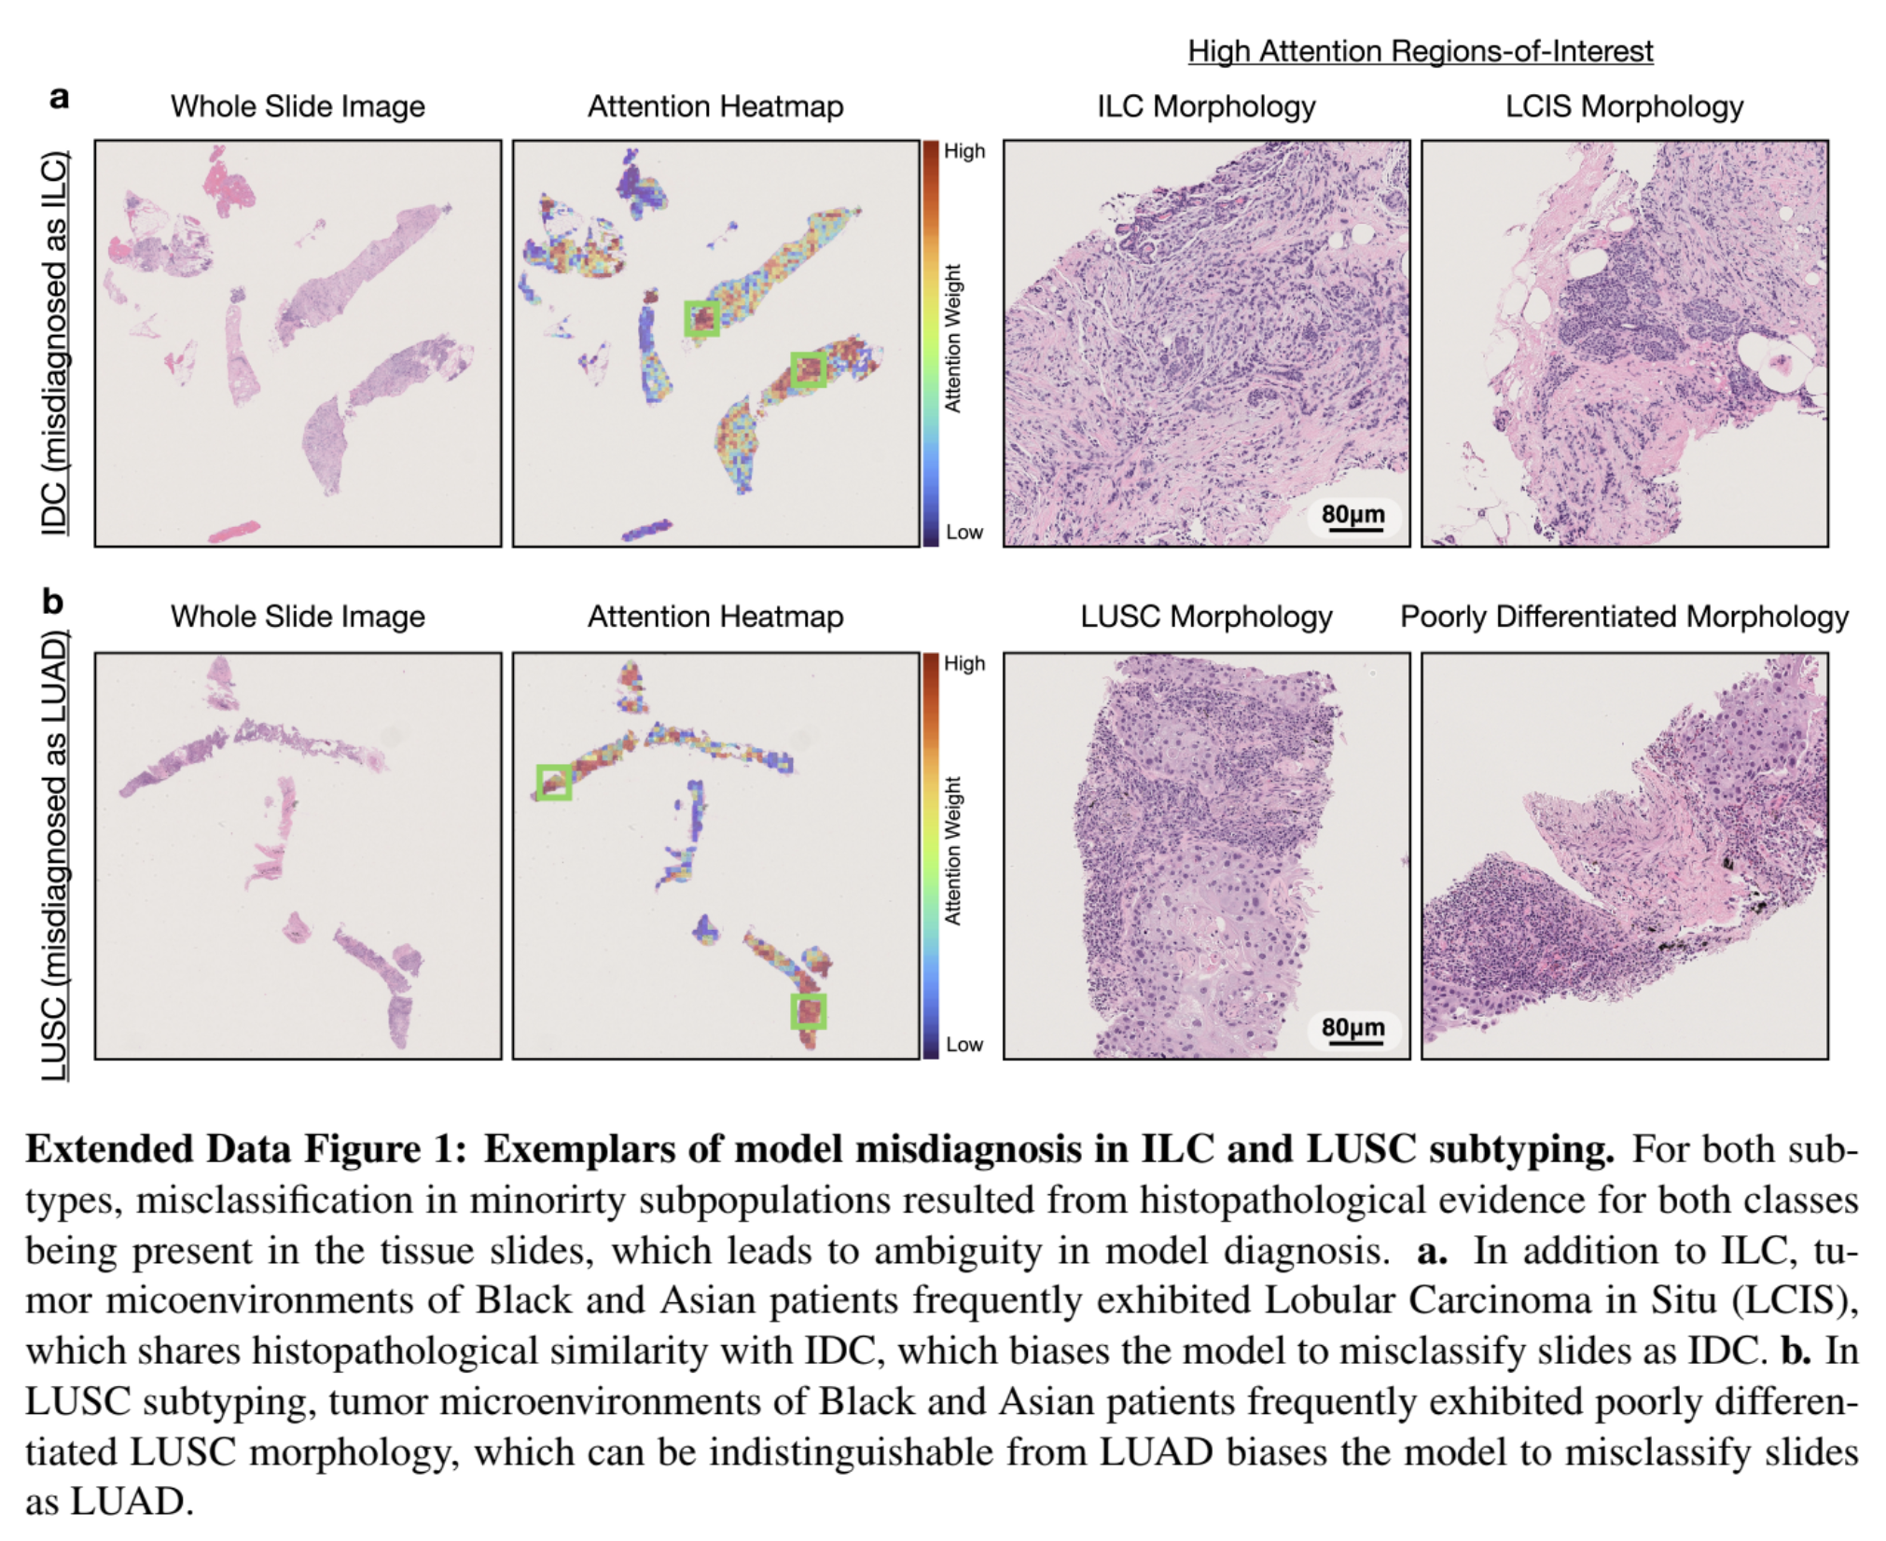
8. Race Disparities in AI Models (Submitted to JAMA)

Slide 13
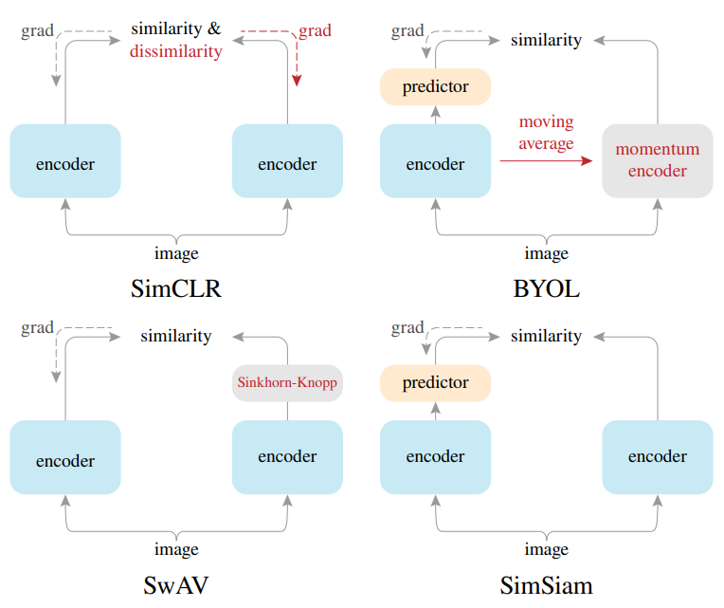
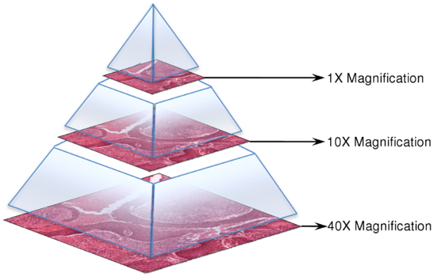
9. Self-Supervision in Pathology (at MSR)
Establishing benchmarks for common SSL methods on TCGA (organ-specific and pan-cancer)​
Exploring proxy objectives for self-supervision in image pyramids
e.g. - Learning a Hierarchical Vision Transformer that learns:
Local representations of 256 x 256 image patches (with 16 x 16 subpatches as embeddings)
Global representations of 150K x 150K image slides (with the previous 256 x 256 patches as embeddings)
Chen & He 2020, Exploring Simple Siamese Representation Learning, arXiv
CAMELYON17 Grand Challenge

